Slide 1
predicting the results of a mental arithmetic test
determining the characteristics of the test taker that affect the result

Slide 2
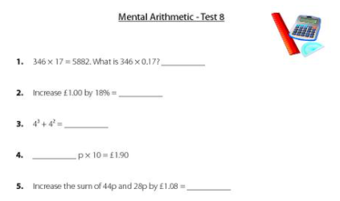
Study description and aims
Mental arithmetic test is designed to measure a person’s ability to answer problems using the basic arithmetic operations: Adding, Subtracting, Multiplying, Dividing and Fractions.
It’s a standardized psychometric assessment test that shows a candidate’s general numerical aptitude.
Aims: Determine which characteristics of a person affect the results of a mental arithmetic test, and therefore his general numerical abilities :
gender
age
general level of intelligence
attentiveness
predisposition to certain types of sciences
practice
, and create a model to predict the results of the test using these attributes.

Slide 3
Sampling and measurements
86
Hoffman residents were invited
- over the age of 14
- age and gender proportions were observed
69
participants were at the beginning of the study
62
participants took part from start to finish
17 candidates
did not consent
7 participants
withdrew

Slide 4
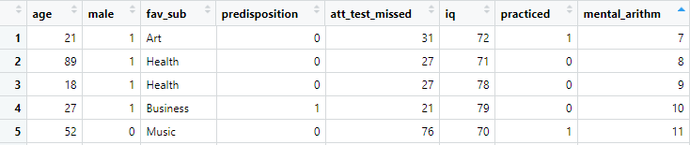
Sampling and measurements
62 rows X 8 columns
Participants’ age, gender and favourite subjects back in school were recorded
Favourite subjects were grouped into two categories:
0 – humanities and 1 – subjects that involve critical thinking and work with numbers
Participants were asked to pass Attention test and IQ test. Results were recorded
Before passing Mental Arithmetic test they were randomly divided into two groups. One of the groups practiced with a problem solving
Mental Arithmetic test results were recorded

Slide 5
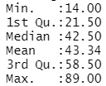
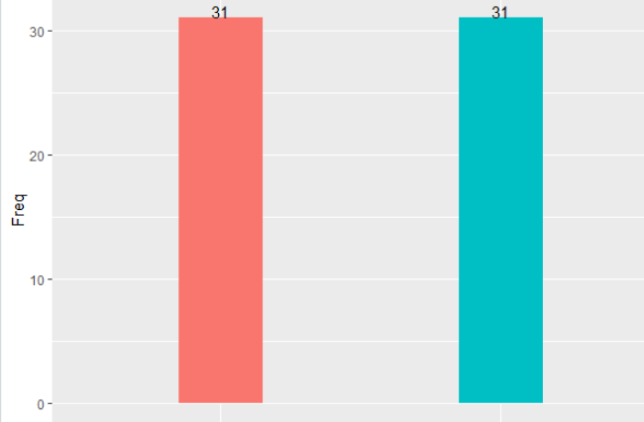
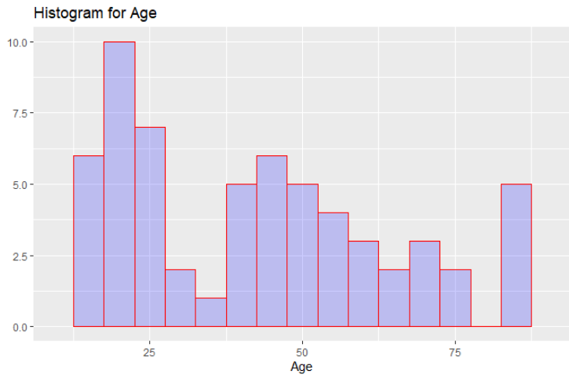
Data summary
Gender
Age
females
males

Slide 6
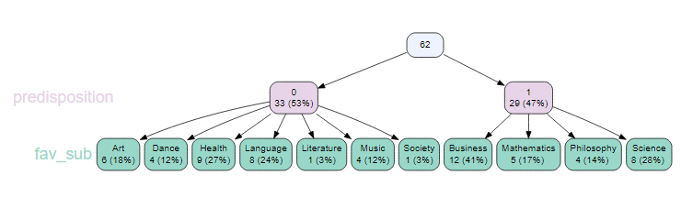
Data summary
Favourite subjects and predisposition

Slide 7
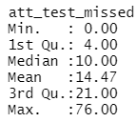
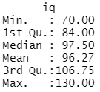
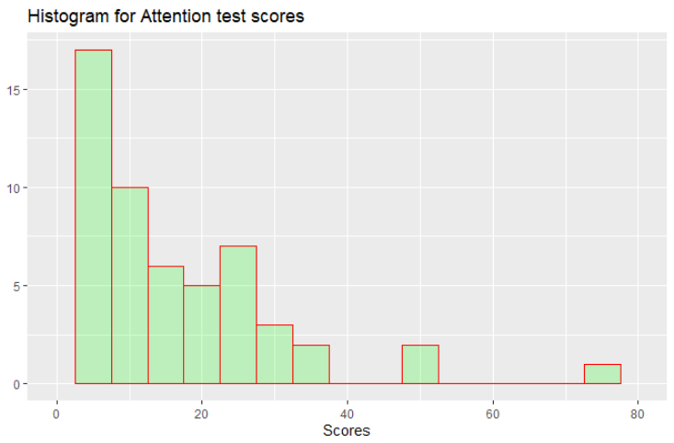
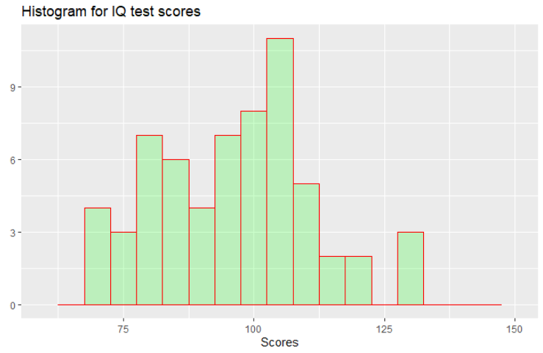
Data summary
Attention test
IQ test

Slide 8
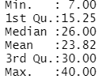
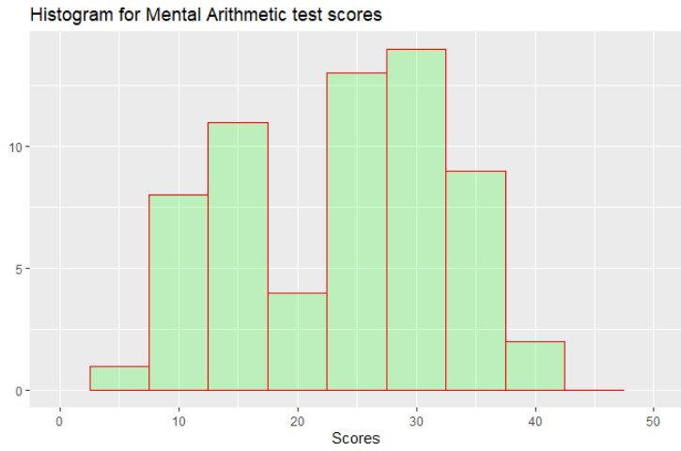
Data summary
Practice
Mental arithmetic test
practiced
did not practice

Slide 9
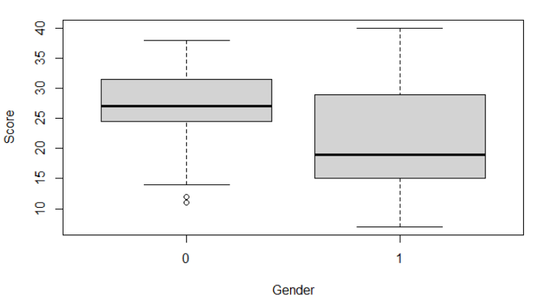
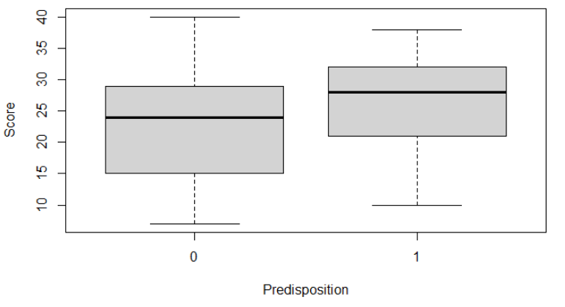
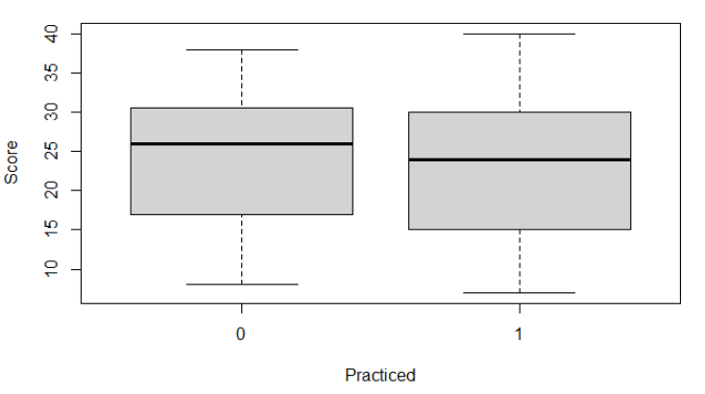
Correlation of attributes to Mental Arithmetic test scores
females
males
humanities
STEM
did not practice
practiced

Slide 10
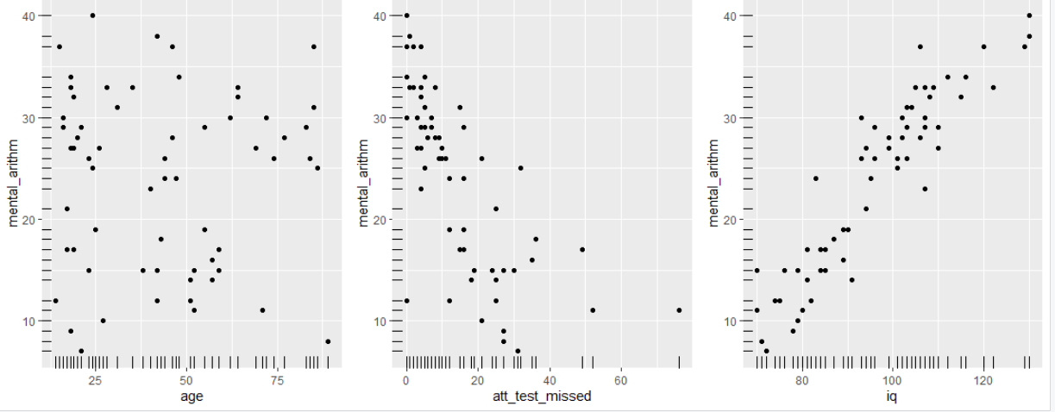
Correlation of attributes to Mental Arithmetic test scores
Age
Attention test
IQ test

Slide 11
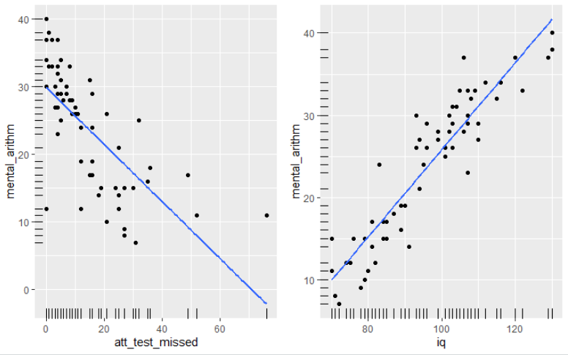
Correlation of attributes to Mental Arithmetic test scores
Attention test
IQ test
A transformation should be applied on ‘att_test_missed’ variable

Slide 12
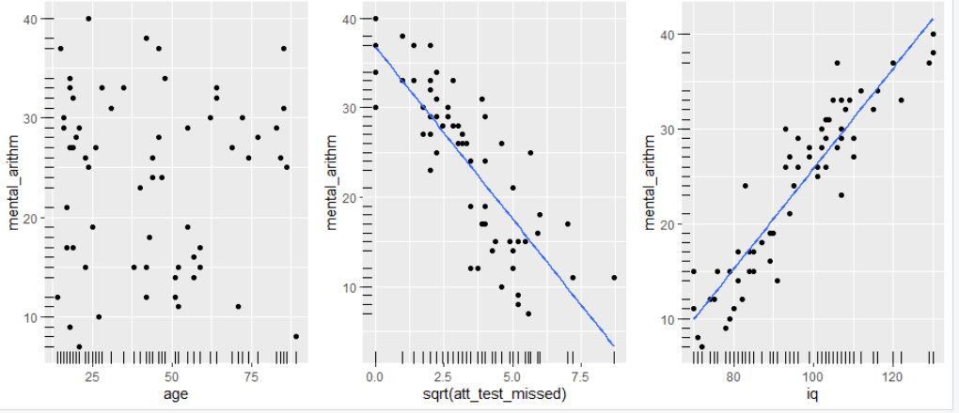
Correlation of attributes to Mental Arithmetic test scores
Attention test
IQ test
Having looked at different transformations, I decided on taking the square root of the results

Slide 13
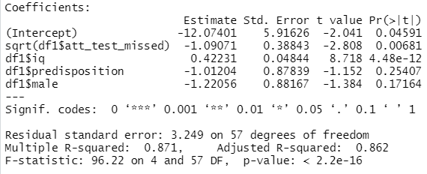
Constructing a Linear Regression Model
= -12.07 - 1.09 * SQRT( ) + 0.42 * - 1.01 * - 1.22 *
Mental Arithmetic test score
Number of missed symbols in attention test
Predisposition to subjects that involve work with numbers
IQ test score
IS MALE

Slide 14
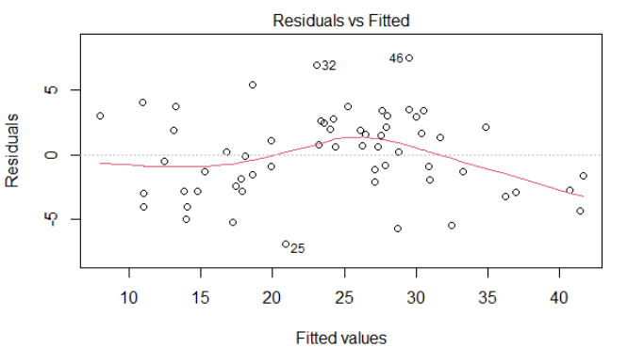
Model diagnostics

Slide 15
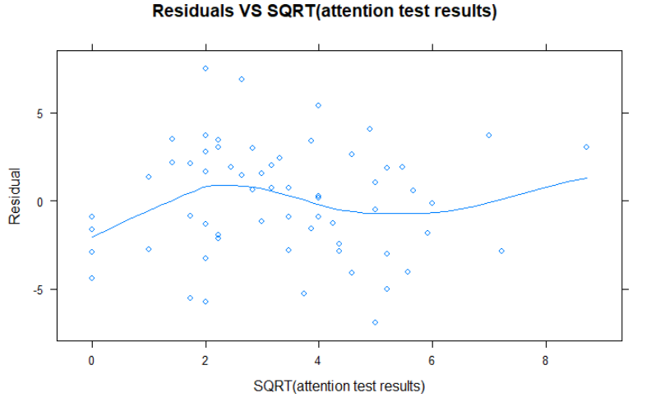
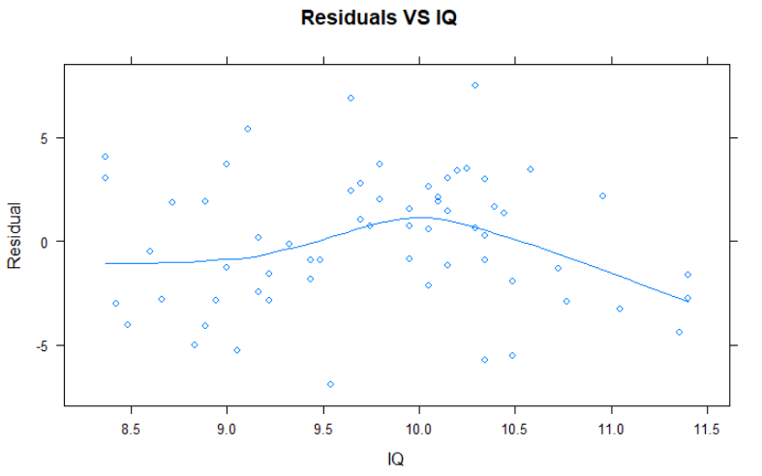
Model diagnostics

Slide 16
Correlation of attributes to Mental Arithmetic test scores
Attention test
IQ test

Slide 17
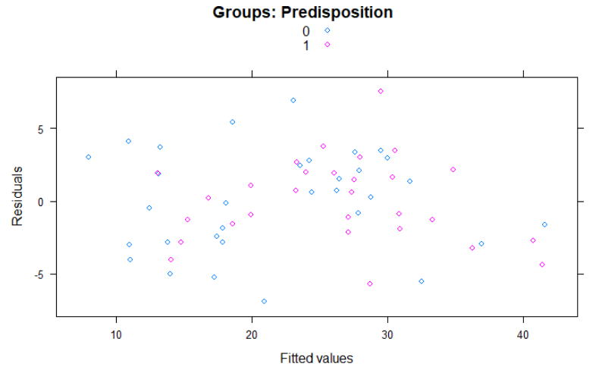
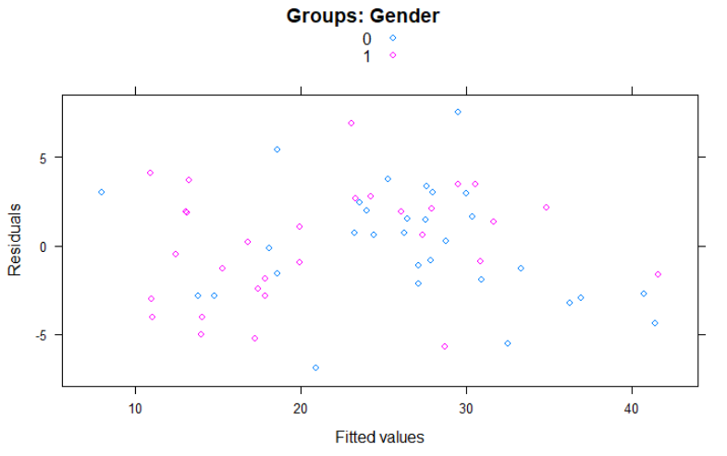
Model diagnostics

Slide 18
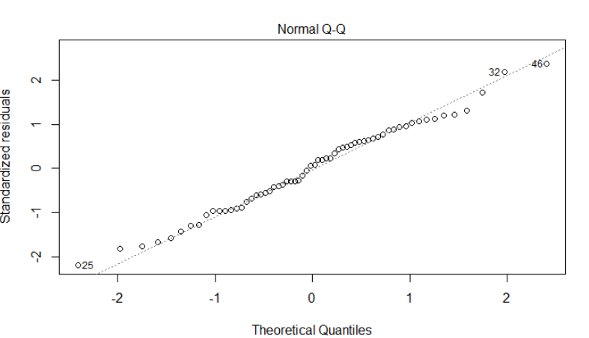
Model diagnostics

Slide 19
Conclusions
Although test scores of females and those who used to love technical subjects in school, on average, were higher, gender and predisposition to certain disciplines shouldn’t be used as Mental Arithmetic test score predictors
Practicing doesn’t affect the results of Mental Arithmetic test
The model can be improved by adding attributes, like the level of education and scores for other mental tests

